Slide 1
Software Engineering
Jian Cao
Shanghai Jiaotong University
Notes:
Today we will start a new course.

Slide 2
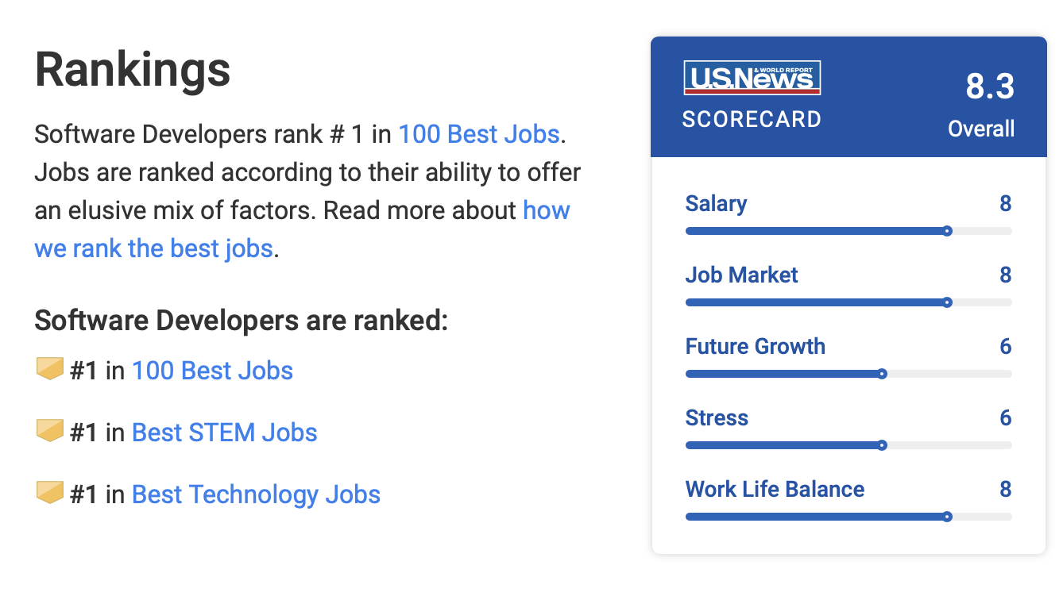

Why?
Why should we learn SE?
Because you are from Computer Science
SE is the second best technology job
http://money.usnews.com/careers/best-jobs/software-developer
Notes:
1. You should know programming. But it is far from enough. You should know how to develop a complex and relative large software.
2. The strong performance of Software Engineer this year can be attributed to two emerging industries: web applications and cloud computing. A proliferation of companies making applications for smartphones and tablets, along with the push to develop "cloud" software hosted entirely online, has made the job market for Software Engineers broader and more diverse.
Analyst [ˈænəlɪst]

Slide 3

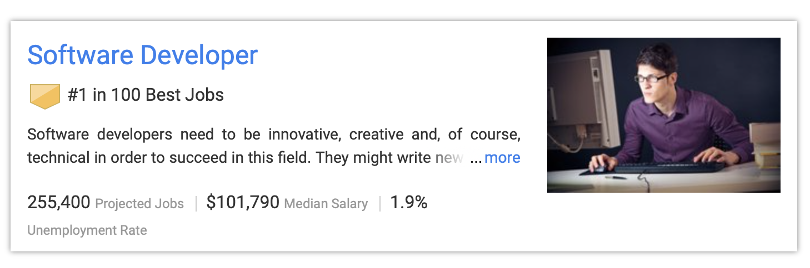
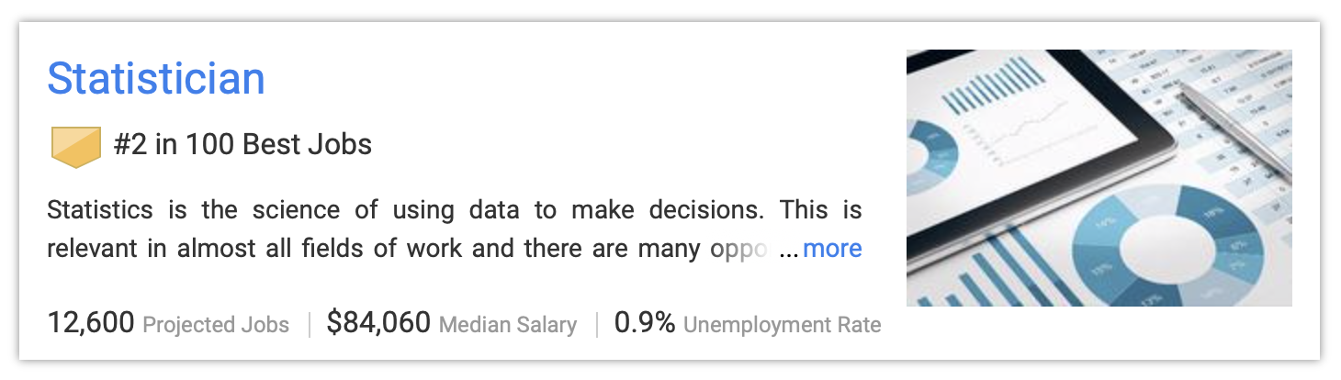

Which job is the best in 2019?

Slide 4
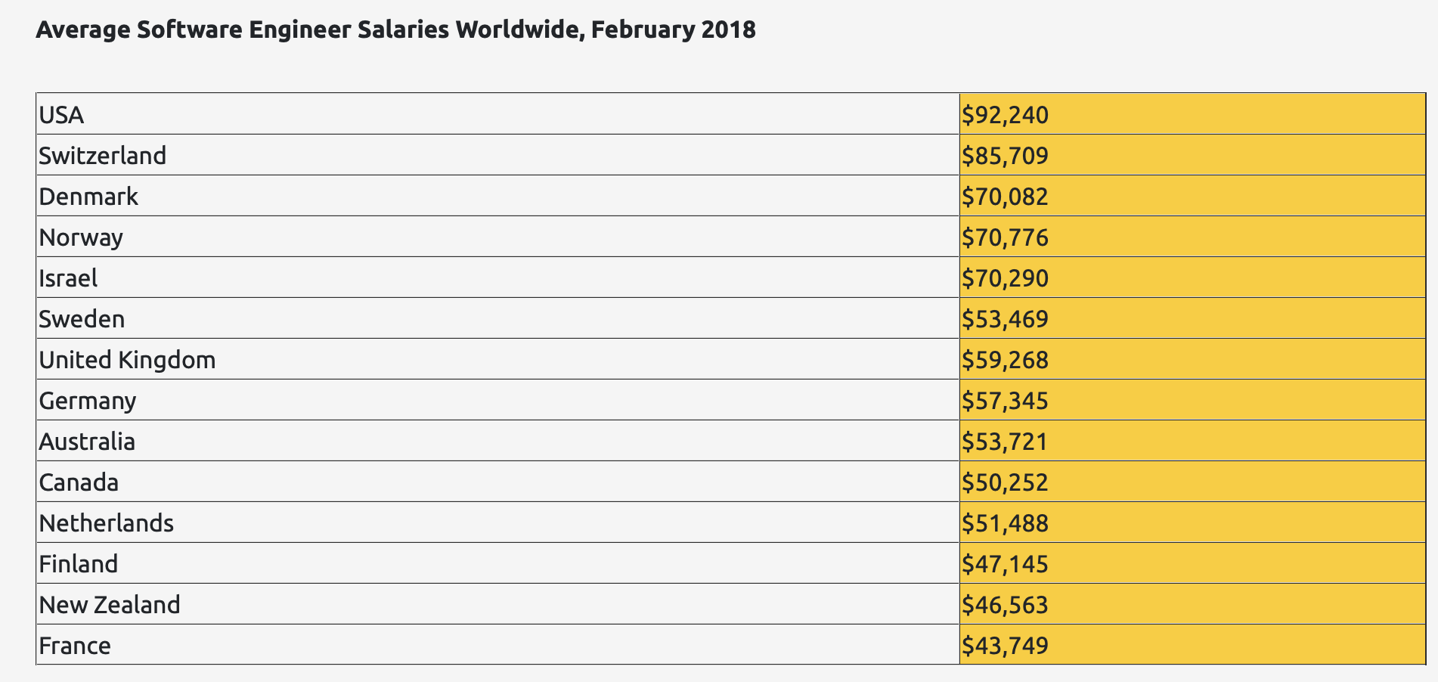
https://www.daxx.com/article/it-salaries-software-developer-trends-2018

Slide 5

What?
The SWEBOK Knowledge Areas (KAs)
Software requirements
Software design
Software construction
Software testing
Software maintenance
Software configuration management
Software engineering management
Software engineering process
Software engineering models and methods
Software quality
Software engineering profressional practice
https://www.sebokwiki.org/wiki/An_Overview_of_the_SWEBOK_Guide
Notes:
IEEE, is the largest organizations for technical professionals.
They organized a group of experts to summarize the knowledge included in SE.
SWEBOK represents guide to the software engineering Body of Knowledge

Slide 6
Software Engineering vs. Computer Science
Computer science is concerned with theory and fundamentals; software engineering is concerned with the practicalities of developing and delivering useful software
Computer science theories are currently insufficient to act as a complete underpinning for software engineering
Notes:
This difference leads to that computer scientists and software engineers are two kinds of peoples

Slide 7


Computer Scientist
Proves theorems about algorithms, designs languages, defines knowledge representation schemes
Has infinite time…
Engineer
Develops a solution for an application-specific problem for a client
Uses computers & languages, tools, techniques and methods
Has finite (usually not enough) time…
Software Engineer
Works in multiple application domains
Has only 3 months...
…while changes occurs in requirements and available technology
Notes:
Theorem /ˈθɪərəm/
Finite [ˈfaɪnaɪt]
A computer scientist assumes that techniques, methodologies and tools are to be developed. They investigate in designs for each of these weapons, and prove theorems that specify they do what they are intended to do. They also design languages that allow us to express techniques. To do all this, a computer scientist has available an infinite amount of time.
A software engineering views these issues as solved. The only question for the software engineer is how these tools, techniques and methodologies can be used to solve the problem at hand. What they have to worry about is how to do it under the time pressure of a deadline. In addition they have to worry about a budget that might constrain the solution, and often the use of tools. Good software engineering tools can cost up to a couple of $10,000 Dollars (Galaxy, Oracle 7, StP/OMT)

Slide 8
This course
SE Concept
UML
Project Organization and Management
Requirement Elicitation
Analysis
System Design
Object Design
Mapping Models to Code
Testing
Manage Change
Notes:
This course focus on modern software engineering, i.e., object-oriented software engineering.
Although traditional software engineering concepts like dataflow diagram, functional module decomposition are still used, object –oriented software engineering plays the main roles now.

Slide 9
How?
Reading
Practice
Notes:
Read software written by other peoples
Attention, don’t copy from others
By reading, we should learn how they apply software development to solve the domain problems.
Copying means you steal others intellectual property.
Develop software using the knowledge learned from this course.
We will have some assignments. More importantly, We have another practical course.

Slide 10
Main Case Studies
Online Game Platform: ARENA
Provide a generic infrastructure for operating an arena to
Support virtual game communities.
Register new games
Register new players
Organize tournaments
Keeping track of the players scores.
Provide a framework for tournament organizers
to customize the number and sequence of matchers and the accumulation of expert rating points.
Provide a framework for game developers
for developing new games, or for adapting existing games into the ARENA framework.
Provide an infrastructure for advertisers.

Slide 11
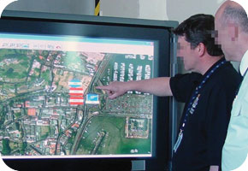
Accident Management System
ReportEmergency
OpenIncident
AllocateResources

Slide 12
NextGen point-of-sale (POS) system
A POS system is a computerized application used (in part) to record sales and handle payments; it is typically used in a retail store

Slide 13
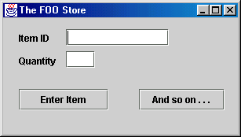
minor focus
Interface
explore how to connect to
other layers
application
primary focus of
logic and
Sale
Payment
case study
domain object
explore how to
layer
design objects
secondary
focus
technical
Log
PersistenceFacade
services layer
explore how
to design
objects

Slide 14
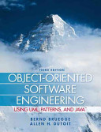

Course Website: http://cc.sjtu.edu.cn
面向对象软件工程
About Myself:
Jian Cao, Prof., Ph.D
Office Room: 3-413
Phone: 021-34204426, 13651963843
E-Mail: cao-jian@sjtu.edu.cn
Text Book
Notes:
I think you already have this book with you.

Slide 15
Thanks cao-jian@sjtu.edu.cn
Notes:
Break

